Slide 1

Skelly
A MIND BOOSTER GAME
Supervised by:
Dr. Manal Tantawi
T.A. Aya Nasser

Slide 2
Team Members
Ahmed Awad Sayed
Abdelrahman Emam Fadl
Caroline Atta Samy
Ezz Khalil Abdel-halim
Mohamed Mohamed Khalefa
Mohammed Abdelraouf Ahmed

Slide 3
CONTENT
1
Problem Definition
2
Motivation
3
Objective
4
Survey
5
System Archeticture
6
Skelly Time
7
Conclusion
8
Future Work

Slide 4

Problem Definition

Slide 5

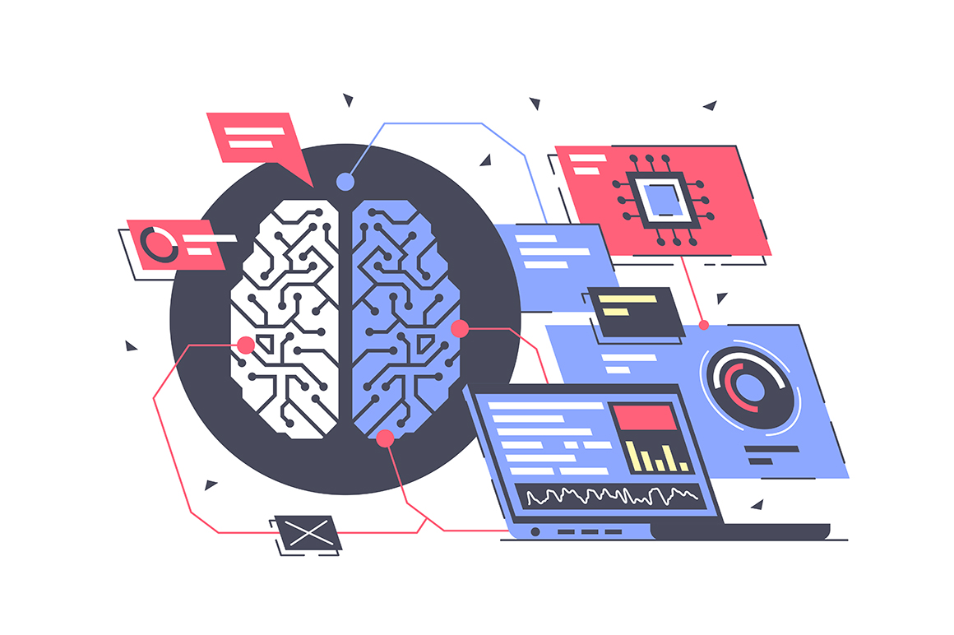
Brain-computer interface (BCI)
Technology that enables direct communication between the human brain and external devices

Slide 6
BCI Strategies
Invasive
refers to interfaces that require surgical implantation of devices or electrodes directly into the brain to enable communication between the brain and external devices or computers.

Slide 7
BCI Strategies
Invasive
Non-Invasive
Invasive
refers to interfaces that require surgical implantation of devices or electrodes directly into the brain to enable communication between the brain and external devices or computers.
do not require surgical procedures and instead use external sensors to detect brain activity.
Common non-invasive BCI methods include electroencephalography (EEG)

Slide 8
What is EEG Signals?
Is a method to record an electrogram of the spontaneous electrical activity of the brain.

Slide 9
What is EEG Signals?
Is a method to record an electrogram of the spontaneous electrical activity of the brain.
EEG predominantly captures electrical activity in the cerebral cortex. The spatial resolution of EEG is typically poor (in the square centimeter range) but the temporal resolution is good (in the milliseconds range)

Slide 10
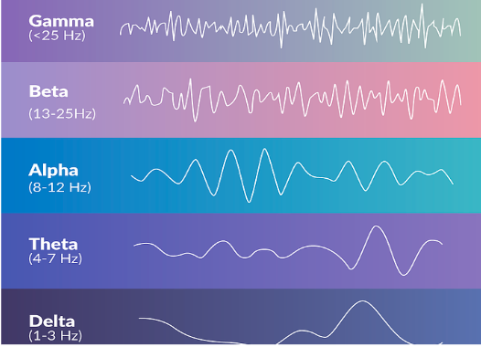
EEG band can be decomposed to 5 sub-bands:
Delta waves (0.5-4Hz)
Theta waves (4-8Hz)
Alpha waves (8-13Hz)
Beta waves (13-30Hz)
Gamma waves (30-100Hz)

Slide 11
BCI Goals:
1- To enable people with damaged neural pathways to control their environment via Reanimation of paralyzed limbs and control of robotic devices
2-BCI systems will have a great societal impact growing interest from the industry to commercialize and market BCI systems for medical and non-medical applications like (gaming)

Slide 12
BCI from different prespectives:
Considered mental strategy
Evoked potential

Slide 13
BCI from different prespectives:
Considered mental strategy
Evoked potential
Motor imagery

Slide 14
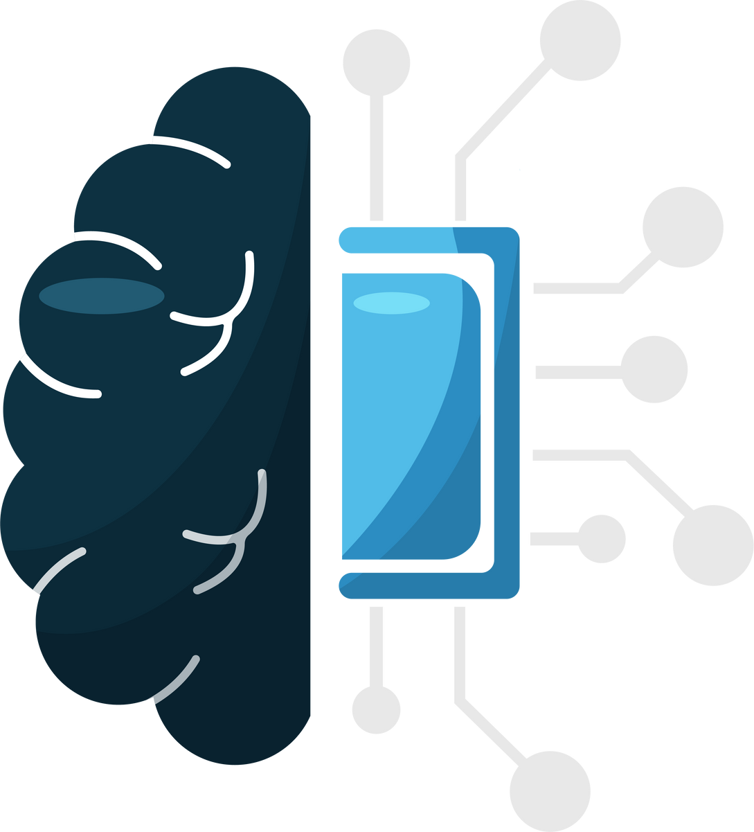
What is Motor Imagery?
it refers to the mental simulation or visualization of specific motor actions without physically executing them

Slide 15
What is Motor Imagery?
it refers to the mental simulation or visualization of specific motor actions without physically executing them
Motor Imagery is widely used for brain-computer interfacing in humans is neural activity produced when a subject voluntarily imagines making a movement. Imagining a movement typically produces neural activity that is spatiotemporally like the activity generated during actual movement, but smaller in magnitude.

Slide 16
Motor imagery can detect various classes, such as left-hand, right-hand, or foot movement and tongue, depending on the complexity of tasks and the precision of the detection system.
Classifiers can be applied to discriminate between two or more types of imagined movements, allowing each imagined activity to be mapped to a particular control signal (e.g., moving a cursor up).

Slide 17
Motor imagery can detect various classes, such as left-hand, right-hand, or foot movement and tongue, depending on the complexity of tasks and the precision of the detection system.
Classifiers can be applied to discriminate between two or more types of imagined movements, allowing each imagined activity to be mapped to a particular control signal (e.g., moving a cursor up).
MI applications:
Rehabilitation and Restoration
BCI Speller
Brain to Vehicle
Image Reconstruction from Brain data
brain-to-text communication via handwriting
Speech from Brain signals
Games and entertainment

Slide 18
What is Skelly?

Slide 19
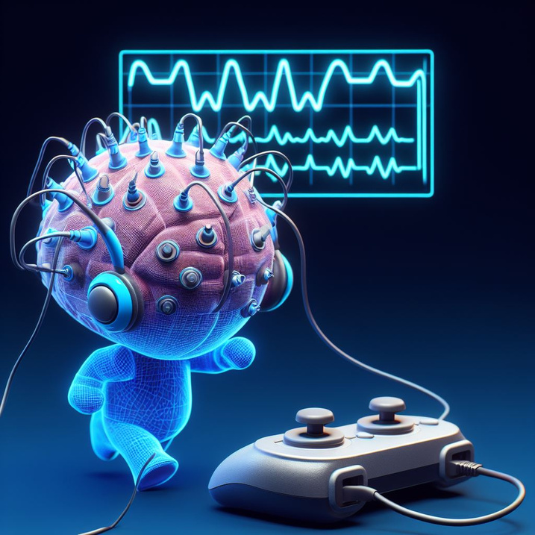
What is Skelly?
Skelly is a game that uses brain signals (EEG) using electrodes attached to the scalp to create a fun and engaging gaming experience. It’s a type of brain-computer interface (BCI) application, which is a technology that allows users to communicate or control devices or applications with their thoughts. so it can be used for rehabilitation purposes, as it provides feedback, motivation, and stimulation to users who need to improve their abilities or recover from brain injuries, In a number of levels graded in difficulty

Slide 20
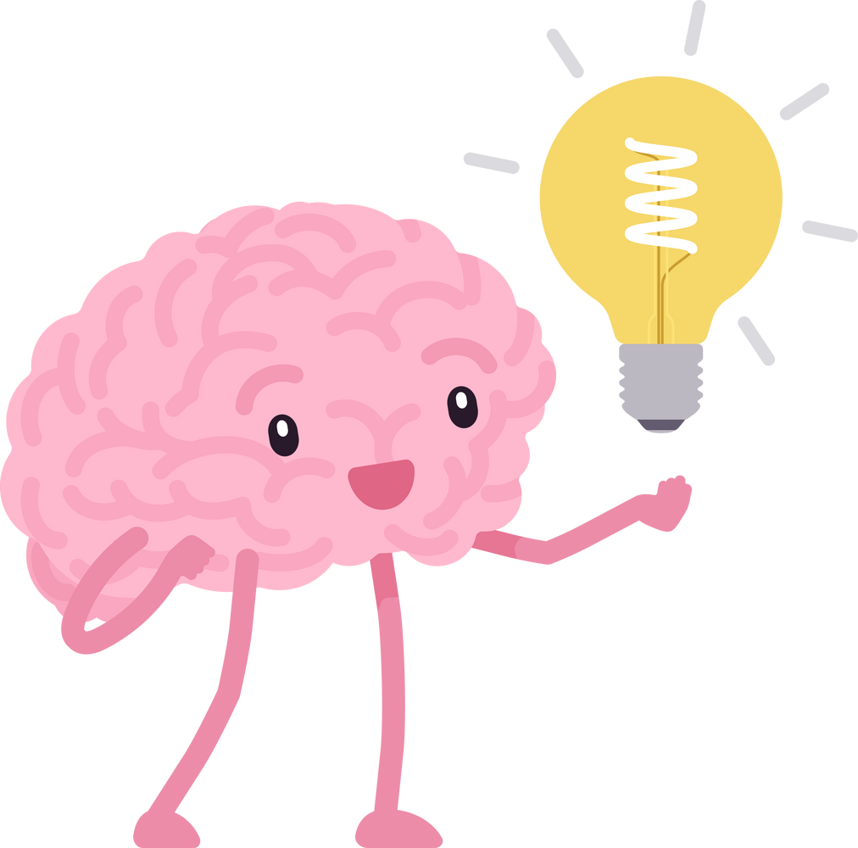
Motivation

Slide 21
There are 1.3 billion people with disabilities in the world, which is about 16% of the total population. Some of them suffer from brain diseases such as ALS, which usually affects people between 40 and 70 years old, but can also occur at younger ages. ALS can be classified into two types: sporadic, which accounts for 90-95% of all cases, and familial, which is inherited and affects a small number of people. ALS causes five deaths per 100,000 people aged 20 or older.

Slide 22
So this project aims to help people who have disabilities or brain injuries that impair their motor and communication abilities. It uses a type of BCI called MI EEG signal, which can detect the user’s intention from their brain activity when they imagine performing a movement. MI EEG signal can enable the users to control devices, communicate, or restore mobility. The project seeks to enhance the accuracy, variability, and usability of the existing MI EEG systems.

Slide 23

Objective

Slide 24
Designing a game utilizing Brain-Computer Interface (BCI) technology to aid in the rehabilitation and enjoyment of individuals affected by brain injuries or disabilities.

Slide 25

Survey

Slide 26

After reviewing about 20 research papers about EEG classification and motor imagery And creating an individual survey for each paper, this comprehensive analysis led to the identification of the BCI competition IV 2A as an ideal choice for the project

Slide 27
BCI Competition IV 2A Dataset:
4 classes: Right, Left hand, Both feet, Tongue
Consists of 9 subjects
Each subject was recorded in 2 sessions in different days
Each session has 6 runs, each run has 48 trials which is 12 trials for each class
Cue based (Synchrouns)
Subject dependent

Slide 28
paper no.
Year
Pre-processing
Classification
Accuracy
Band-pass filter, Data augmentation, Converting signals to Freq. domain
Multi-level binary classification
[1]
2019
87.99%
Band-pass filter, CSP
,Segmentation, Z-score
[2]
2021
CNN Model
71.25%
__________________
Deep multi-view feature learning
0.627 78.5%
[3]
2020
[4]
2023
__________________
MSAE-NET
69.98–12.15%

Slide 29
paper no.
Year
Pre-processing
Classification
Accuracy
Band-pass filter, CSP
,Butterworth band-pass filter
CSP-SVM,
CSP-BA-SVM,
CSP-AM-SVM,
CSP-AM_BA_SVM
CS: [OP. time] 0.71, 78.55%
[fixed time] 0.51, 63.74%
CBS: 0.62, 72.7%
CAS: 0.63, 72.61%
CABS: 0.71 78.55%
[5]
2018

Slide 30
Survey’s Notes:
Most Pre-processing techniques that used in preview papers:
Band-pass filter
Segmentation
data augmentation

Slide 31
Survey’s Notes:
Most Pre-processing techniques that used in preview papers:
Band-pass filter
Segmentation
data augmentation
Most feature extraction and reduction techniques used:
Common spatial pattern(CSP)
Channel selection

Slide 32
Survey’s Notes:
Most Pre-processing techniques that used in preview papers:
Band-pass filter
Segmentation
data augmentation
Most feature extraction and reduction techniques used:
Common spatial pattern(CSP)
Channel selection
Most classification techniques used :
Deep learning models like CNN models (with different architectures)

Slide 33

System Architecture

Slide 34
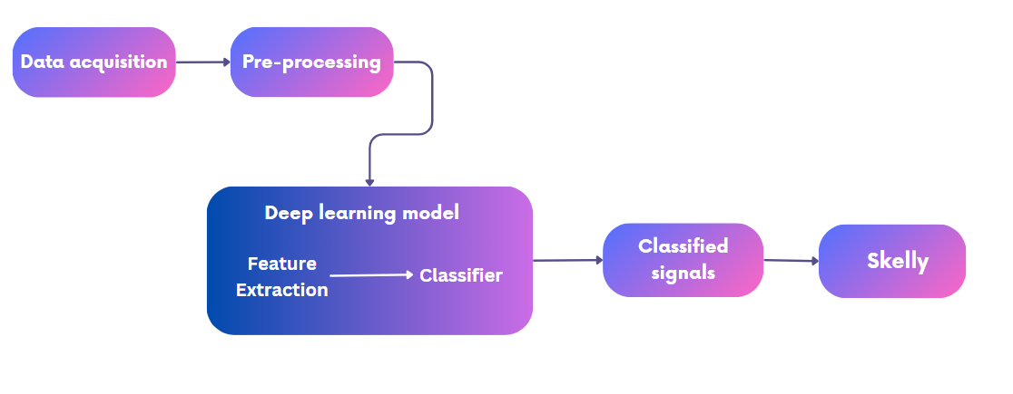

Slide 35
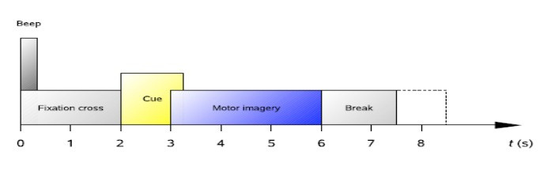
1-Data acquisition
at the beginning (t=0) a fixation cursor appeared on the screen and a short tone was presented (beep)
after two seconds(t=2) a cue in the form of an arrow pointing to either left, right, up, or down stayed on the screen for 1.25 sec
then the subject was asked to carry out the MI task until the fixation cursor disappeared from the screen at t=6, and a short break followed when the screen was black again.

Slide 36
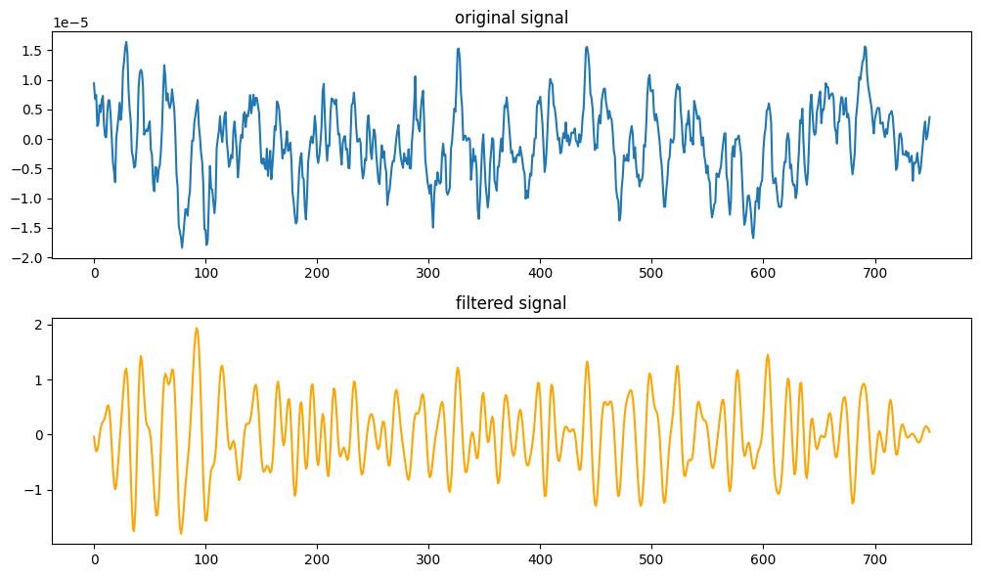
2-Data Pre-processing
Filtering using band-pass filter (Lowcut=8Hz,Highcut=30Hz,Order=5)
Z-Score normalization
Segmentation
(MI task 3sec:6sec)
(1.5sec:6sec)

Slide 37
Classification Models:

Slide 38
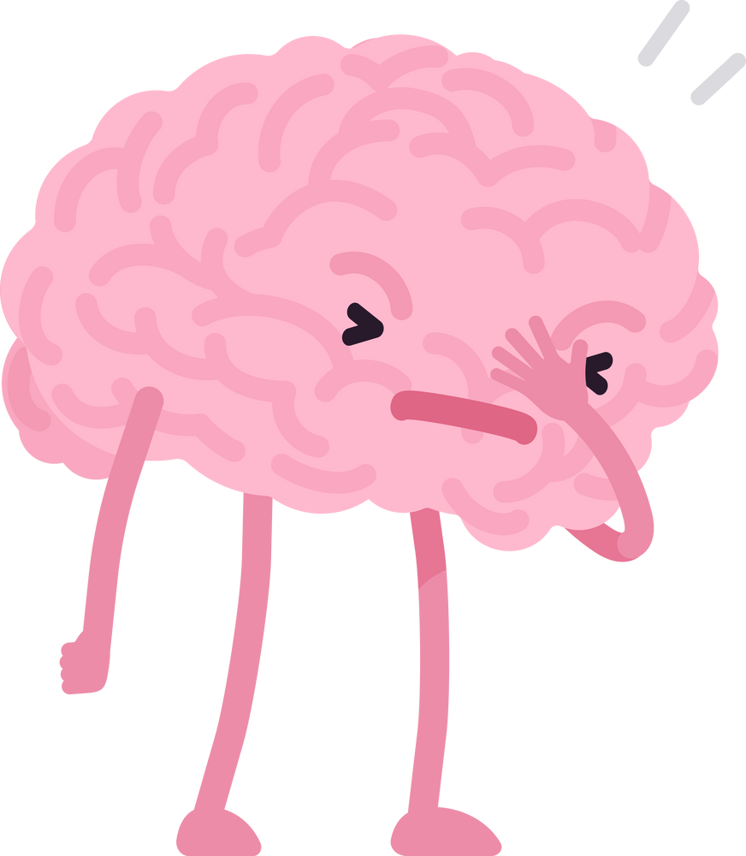
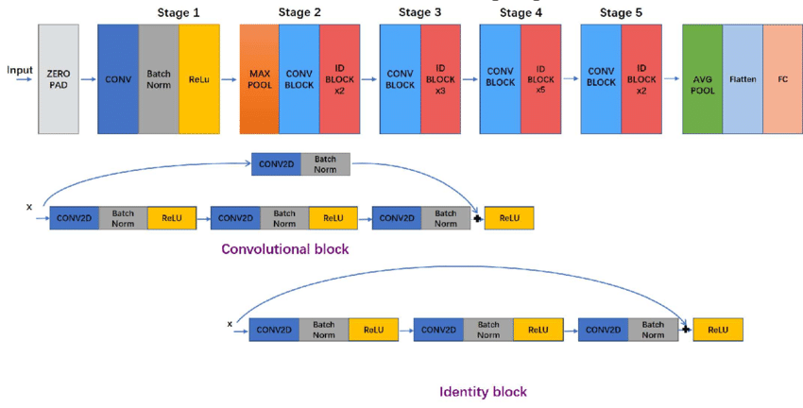
Classification Models:
Resnet50: (ACC.=42%)

Slide 39
Resnet 50
# Subjects
Accuracy
Subject 1
30%
Subject 2
32%
Subject 3
35%
Subject 4
40%
Subject 5
41%
Subject 6
45%
Subject 7
50%
Subject 8
55%
Subject 9
60%
Avg. Accuracy
42%

Slide 40
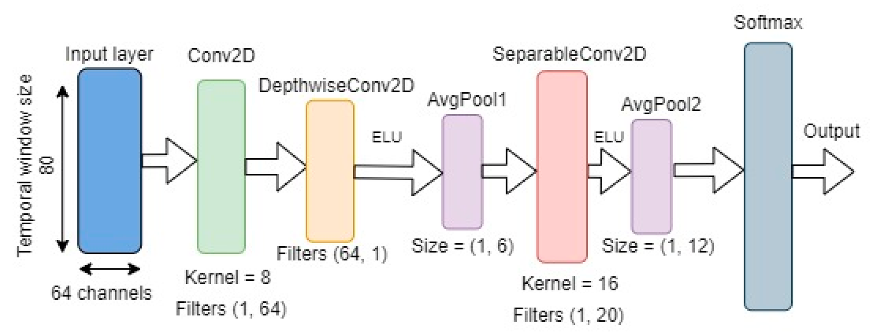
Classification Models:
EEGNet: (ACC.=55.5%)

Slide 41
EEGNet
# Subjects
paper Accuracy
Accuracy
Subject 1
80%
72%
Subject 2
60%
52%
Subject 3
90%
72%
Subject 4
65%
48%
Subject 5
68%
52%
Subject 6
57%
33%
Subject 7
86%
81%
Subject 8
75%
48%
Subject 9
73%
34%
Avg. Accuracy
72.2%
55.5%

Slide 42
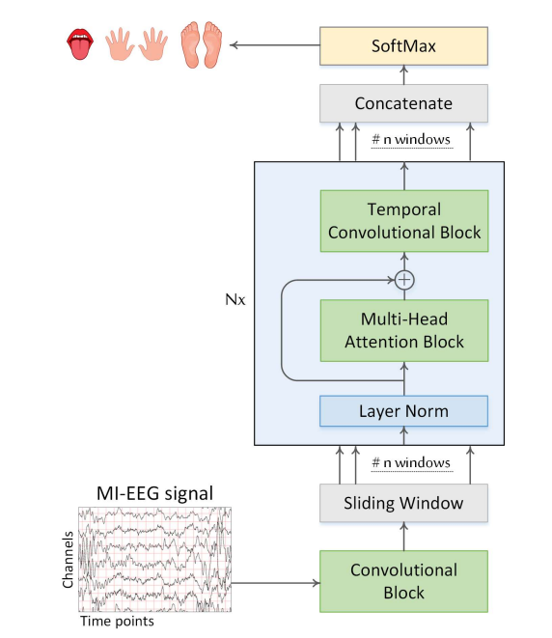
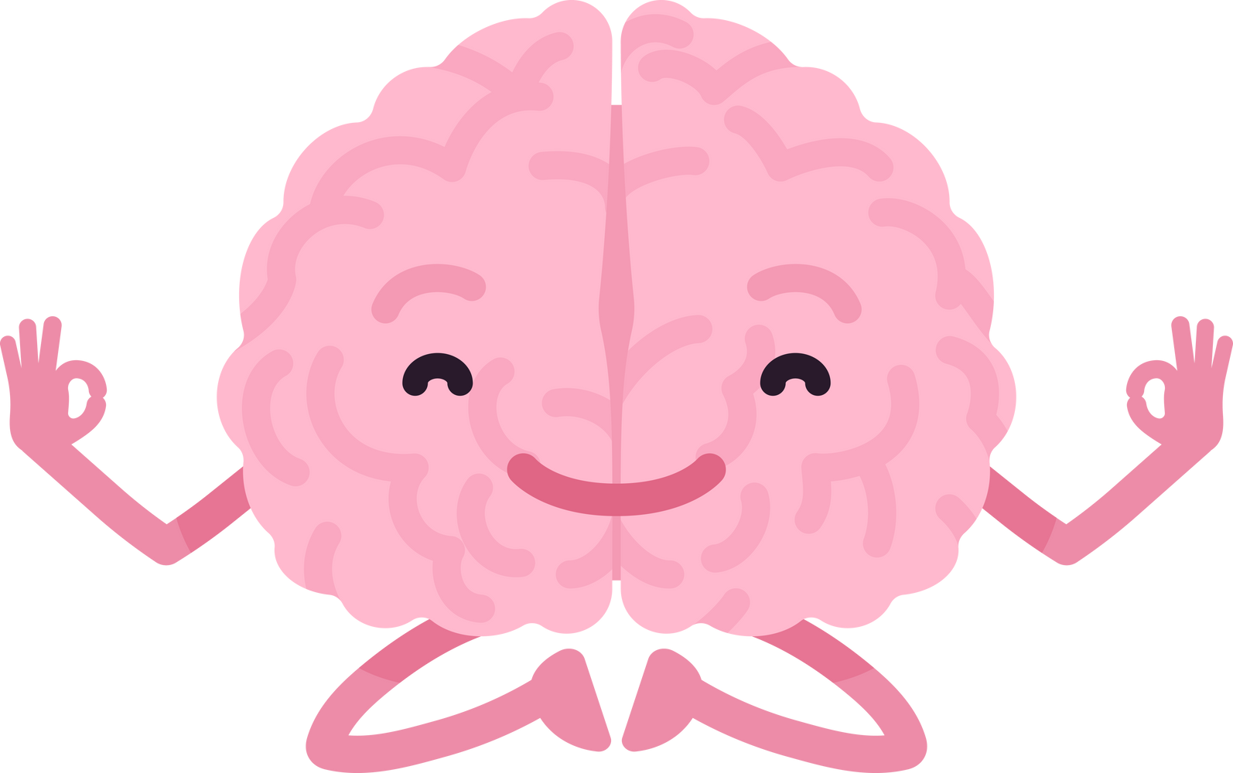
Classification Models:
ATCNet: (ACC.=87.16%)
consists of 3 blocks:
Convolutional block
Attention block
Temporal Convolutional block

Slide 43
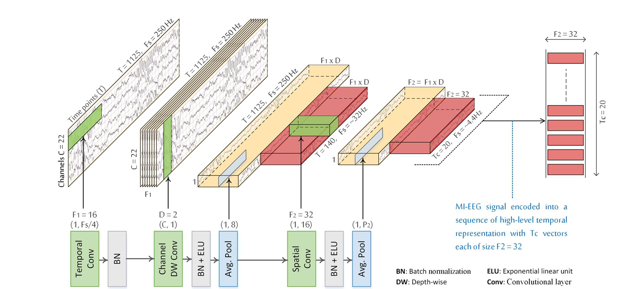
Classification Models:
ATCNet: (ACC.=87.16%)

Slide 44
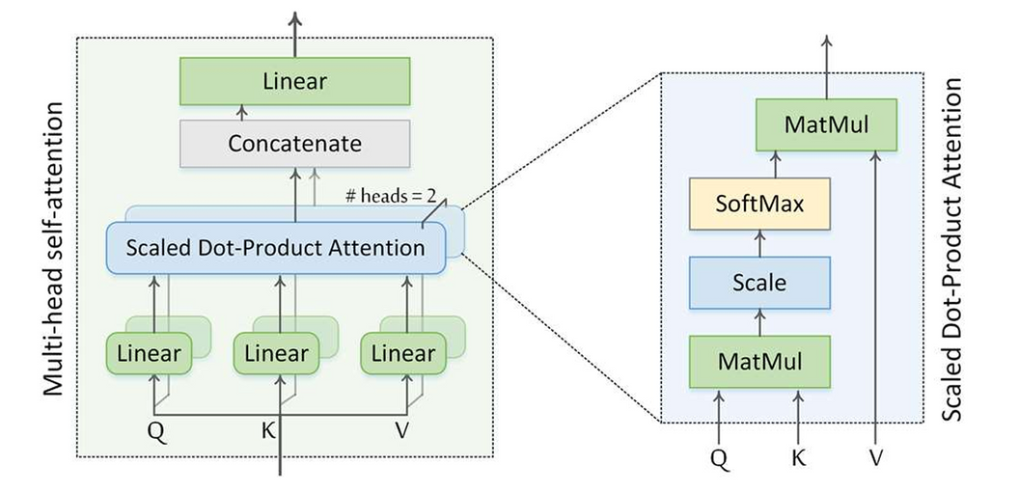
Classification Models:
ATCNet: (ACC.=87.16%)

Slide 45
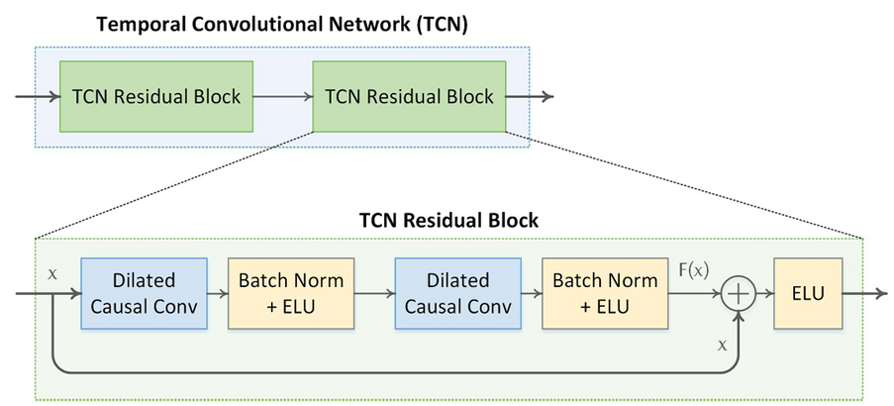
Classification Models:
ATCNet: (ACC.=87.16%)

Slide 46
ATCNet
# Subjects
paper Accuracy
Accuracy
Subject 1
88.5%
84.48%
Subject 2
70.5%
77.59%
Subject 3
97.5%
89.66%
Subject 4
81%
81.03%
Subject 5
83%
87.93%
Subject 6
73.6%
77.59%
Subject 7
93.1%
96.55%
Subject 8
90.3%
94.83%
Subject 9
91%
94.83%
Avg. Accuracy
85.4%
87.16%

Slide 47
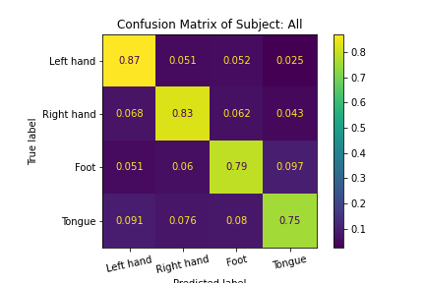
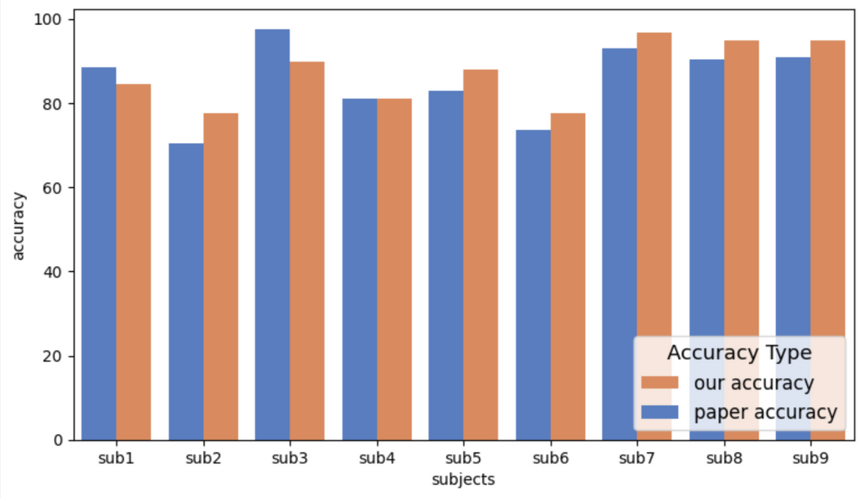

Slide 48
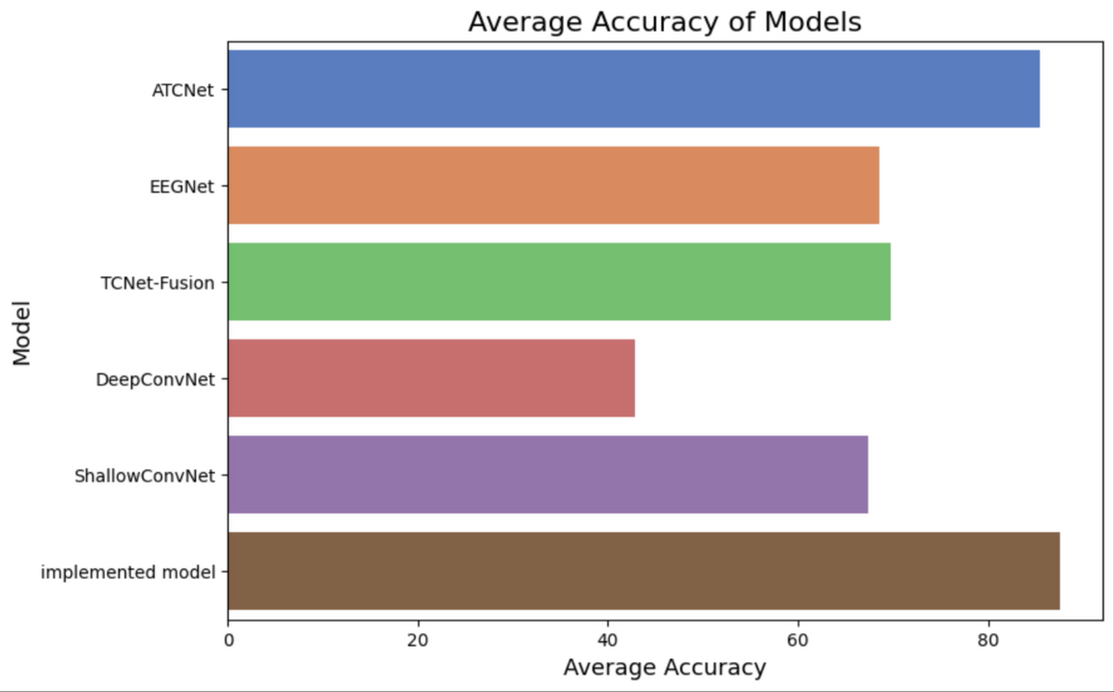
Related works
Model name
Accuracy
ATCNet
[1]
85.4%
EEGNet
[2]
72.2%
TCNet-Fusion
[3]
69.83%
DeepConvNet
[4]
42.78%
ShallowConvNet
[5]
67.48%

Slide 49
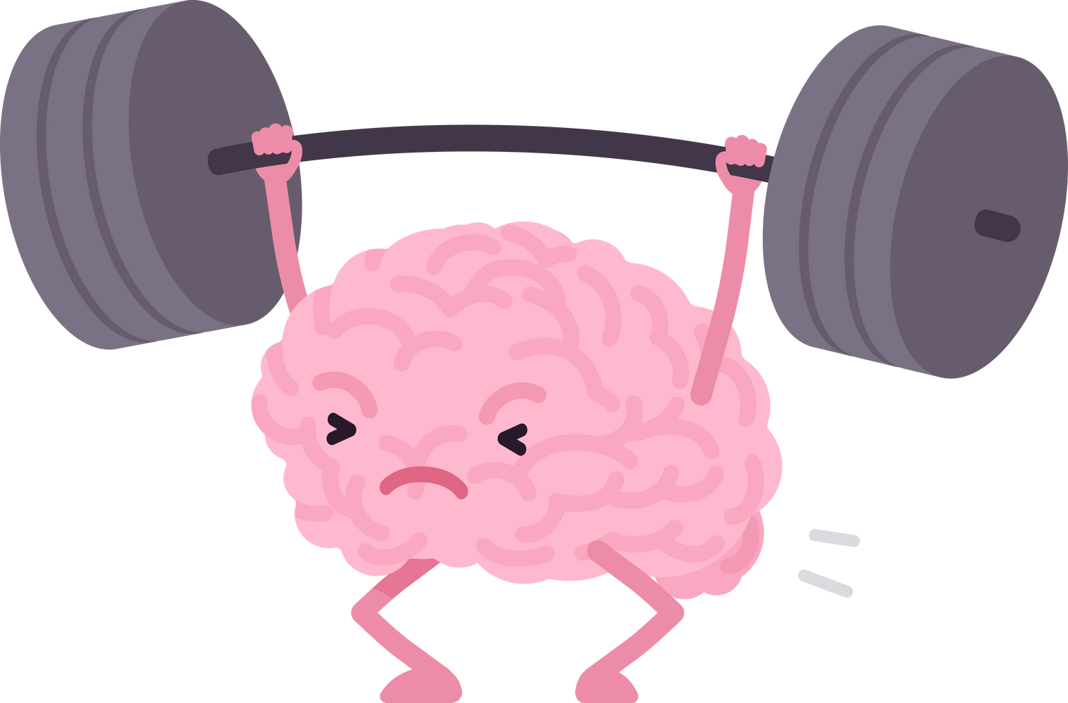
Skelly Time

Slide 50
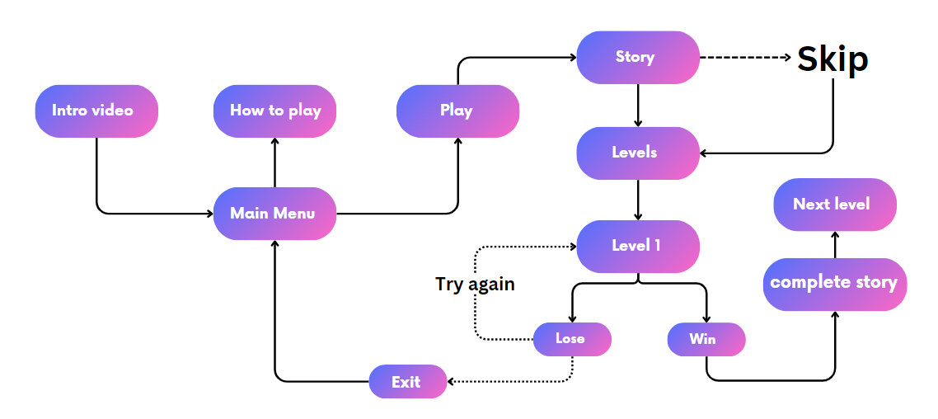

Slide 51


Slide 52
Conclusion

Slide 53

The "Skelly" project integrates Brain-Computer Interface (BCI) technology into gaming, allowing users to control characters using EEG signals. This innovation enables players to navigate through mazes using thoughts alone.
"Skelly" provides an accessible platform for individuals with disabilities or those undergoing rehabilitation, offering a new way to interact with digital environments without traditional input devices.
Utilizing the BCI Competition IV dataset 2a, the ATCNet model was trained to interpret EEG data. This deep learning model achieved 85.4% accuracy in translating users' thoughts into game commands, demonstrating reliability and precision.
"Besides being fun, 'Skelly' helps develop cognitive and motor skills, showcasing how BCI technology can engage users and improve their abilities.“
Skelly's success highlights BCI's potential in assistive tech and rehab. Future improvements could offer more control options, better accuracy, and additional sensory feedback, making BCI useful in daily life.

Slide 54
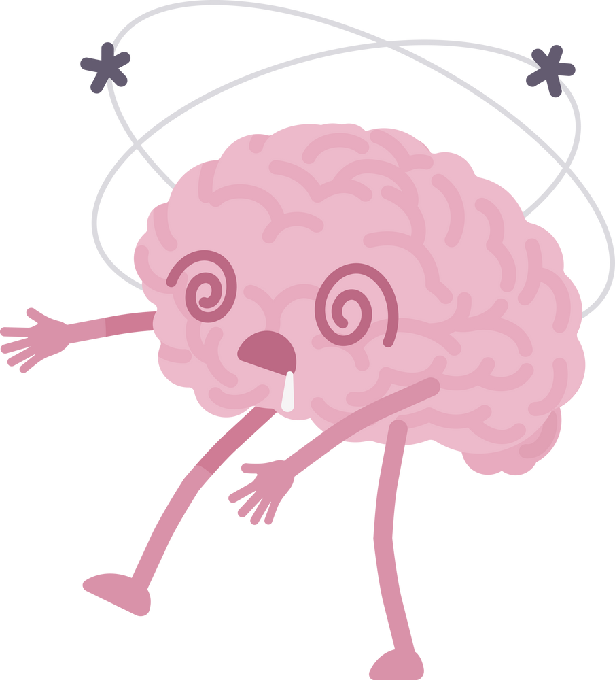
Future Work

Slide 55
Turn the game to real time mode once the availability of the headset

Slide 56
Turn the game to real time mode once the availability of the headset
Add more levels

Slide 57
Turn the game to real time mode once the availability of the headset
Add more levels
Add more challenges in the game

Slide 58
Turn the game to real time mode once the availability of the headset
Add more levels
Add more challenges in the game
Add some improvements in movement algorithm

Slide 59

References

Slide 60
1- Physics-informed attention temporal convolutional network for EEG-based motor imagery classification | IEEE Journals & Magazine | IEEE Xplore. Available at: https://ieeexplore.ieee.org/document/9852687/.
2- eegnet: A compact convolutional network for EEG-based brain-computer interfaces. Available at: https://www.researchgate.net/publication/310953136_EEGNet_A_Compact_Convolutional_Network_for_EEG-based_Brain-Computer_Interfaces.
3- Hassanpour, A., Moradikia, M., Adeli, H., Khayami, S. R., & Shamsinejadbabaki, P. (2019). A novel end‐to‐end deep learning scheme for classifying multi‐class motor imagery electroencephalography signals. Expert Systems, 36(6), e12494.
4- Shajil, N., Mohan, S., Srinivasan, P., Arivudaiyanambi, J., & Arasappan Murrugesan, A. (2020). Multiclass classification of spatially filtered motor imagery EEG signals using convolutional neural network for BCI based applications. Journal of Medical and Biological Engineering, 40, 663-672.
5- Zhang, C., Kim, Y. K., & Eskandarian, A. (2021). EEG-inception: an accurate and robust end-to-end neural network for EEG-based motor imagery classification. Journal of Neural Engineering, 18(4), 046014.
6- Xu, J., Zheng, H., Wang, J., Li, D., & Fang, X. (2020). Recognition of EEG signal motor imagery intention based on deep multi-view feature learning. Sensors, 20(12), 3496.

Slide 61
7- Tangermann, M., Müller, K. R., Aertsen, A., Birbaumer, N., Braun, C., Brunner, C., ... & Blankertz, B. (2019). Review of the BCI competition IV. Frontiers in neuroscience
8-Liao, W., Li, J., Zhang, X., & Li, C. (2023). Motor imagery brain–computer interface rehabilitation system enhances upper limb performance and improves brain activity in stroke patients: a clinical study. Frontiers in Human Neuroscience
9-Li, F., He, F., Wang, F., Zhang, D., Xia, Y., & Li, X. (2020). A novel simplified convolutional neural network classification algorithm of motor imagery EEG signals based on deep learning. Applied Sciences
10-Sadiq, M. T., Yu, X., Yuan, Z., Zeming, F., Rehman, A. U., Ullah, I., ... & Xiao, G. (2019). Motor imagery EEG signals decoding by multivariate empirical wavelet transform-based framework for robust brain–computer interfaces.
11-Majidov, I., & Whangbo, T. (2019). Efficient classification of motor imagery electroencephalography signals using deep learning methods. Sensors,
12-Wang, X., Hersche, M., Magno, M., & Benini, L. (2024). Mi-bminet: An efficient convolutional neural network for motor imagery brain–machine interfaces with eeg channel selection. IEEE Sensors Journal.
13- 1. Mahamune, R., & Laskar, S. H. (2021). Classification of the four‐class motor imagery signals using continuous wavelet transform filter bank‐based two‐dimensional images. International Journal of Imaging Systems and Technology

Slide 62
14-Hassan, E., Hossain, M. S., Saber, A., Elmougy, S., Ghoneim, A., & Muhammad, G. (2024). A quantum convolutional network and ResNet (50)-based classification architecture for the MNIST medical dataset. Biomedical Signal Processing and Contro
15-More, V., & George, K. (2024, February). Incorporating Motor Imagery-Controlled Gaming into Paralysis Rehabilitation. In 2024 IEEE First International Conference on Artificial Intelligence for Medicine, Health and Care (AIMHC) (pp. 72-77). IEEE
16-Ahmed, G. Jeon, and F. Piccialli, “From artificial intelligence to explainable artificial intelligence in industry 4.0: a survey on what, how, and where,” IEEE Trans. Ind. Informatics, vol. 18, no. 8, pp. 5031–5042, 2022.
17-H. Altaheri et al., “Deep learning techniques for classification of electroencephalogram (EEG) motor imagery (MI) signals: a review,” Neural Comput. Appl., pp. 1–42, 2021.
18-D. Zhang, K. Chen, D. Jian, and L. Yao, “Motor imagery classification via temporal attention cues of graph embedded EEG signals,” IEEE J. Biomed. Heal. informatics, vol. 24, no. 9, pp. 2570–2579, 2020.
19-G. A. Altuwaijri, G. Muhammad, H. Altaheri, and M. Alsulaiman, “A Multi-Branch Convolutional Neural Network with Squeeze-and-Excitation Attention Blocks for EEG-Based Motor Imagery Signals Classification,” Diagnostics, vol. 12, no. 4, p. 995, 2022.
20-U. Amin, H. Altaheri, G. Muhammad, M. Alsulaiman, and W. Abdul, “Attention based Inception model for robust EEG motor imagery classification,” in 2021 IEEE International Instrumentation and Measurement Technology Conference (I2MTC), 2021, pp. 1–6.
21-. Xu, H. Zheng, J. Wang, D. Li, and X. Fang, “Recognition of EEG signal motor imagery intention based on deep multi-view feature learning,” Sensors, vol. 20, no. 12, p. 3496, 2020

Slide 63
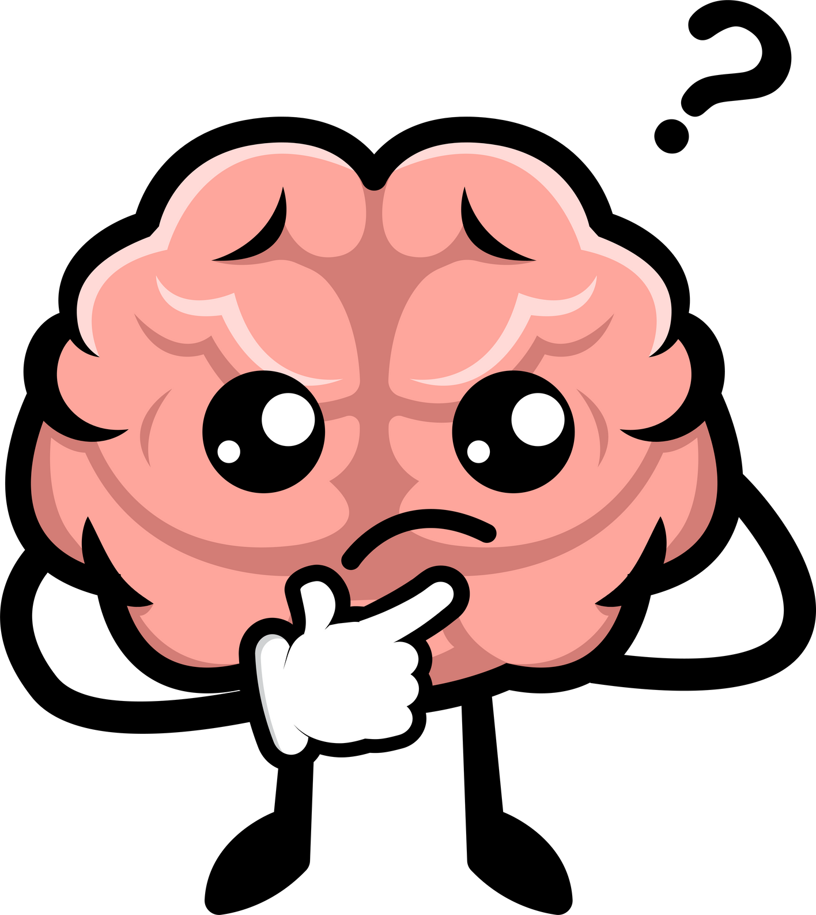
Any Questions

Slide 64
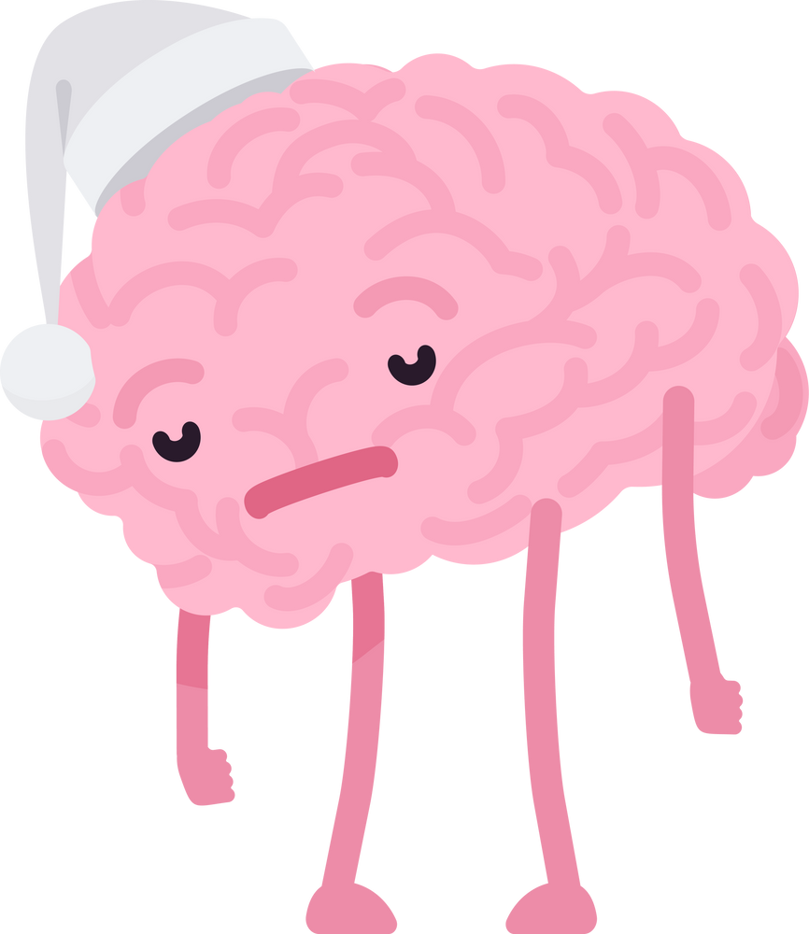
Thank you

